Slide 2
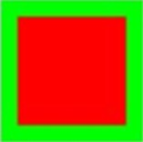
PAP Warmup
Write the processing commands to draw the following shape (this is NOT the whole screen):
What does the method day() do?

